Slide 1

EXPLORE MORE

Slide 2

Design by -
Samidha Vele
Mrunali Virkud
Vipul Karle
GUIDE – Prof. Aniruddha Palsodkar

Slide 3

INTRODUCTION :
This project is a Web-based application that provides a user-friendly and simple interface to let users easily book hotel rooms and perform booking activities via Internet. The records are shared with not only Web users but also with administrators to the site. The project uses a regular Web browser with HTML (Hyper Text Markup Language) as the basic interface language. Users can perform booking activities via the Internet browser. The administrations also can view all users' files and maintain the Web site on it. The Web pages are written in PHP (Hypertext Preprocessor) and stored in apache server. All the data is stored in a MySQL database and accessed by PHP.

Slide 4

Objectives:
To enable online booking via the internet.
To enable automated data entry methods.
Ensure efficient and reliable communication within the hotel.
Avoid data entry errors by use of input masks.
Enable easy authorized modification of data.
Enforce security measures to avoid unauthorized access to guest records.
Enable fast and easy retrieval of guest records and data for fast reference activities

Slide 5

REQUIREMENTS:
SOFTWARE:
• operating system : Windows 11
• Browser : Chrome , Edge
• Visual Studio
• Xampp
2. HARDWARE
• Processor : Intel core i3
• Memory (RAM) : 4GB
• Hard Drive : 1TB
• Graphics Card : Intel Integrated Intel UHD Graphics

Slide 6
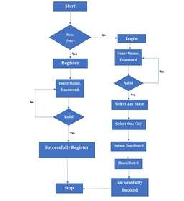
FLOW CHART:

Slide 7

Features :
User-Friendly Interface.
Easy Booking Process
Mobile-Friendly.
Easy Management Of Rooms.
Integrated Payment Gateway.
Easy Search Option.
Image Gallery.
Review System.
Google Maps Integration.
Social Media Links.
Quick And Responsive Customer Support.

Slide 8
Disadvantages:
It needs internet access
You don’t have direct contact with your customers
You might face technical issues
A fast growth can be challenging

Slide 9
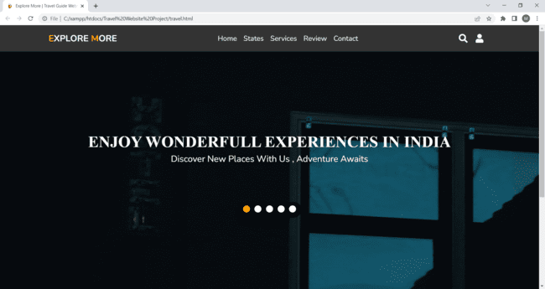
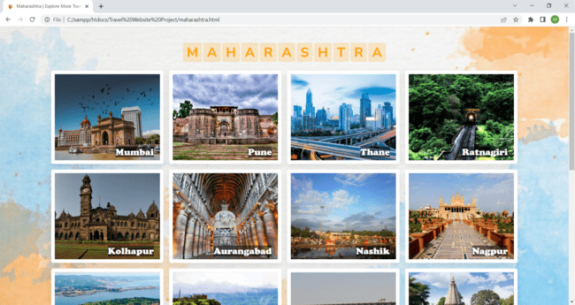
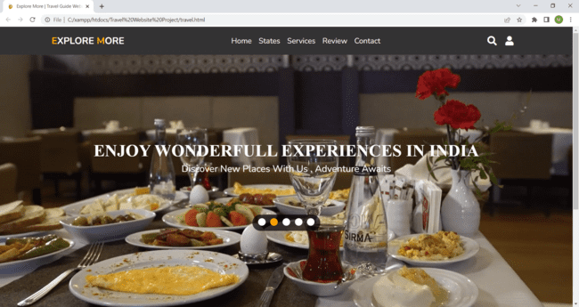
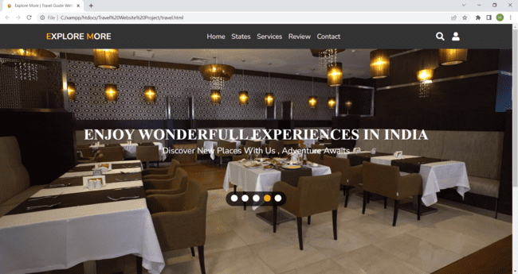
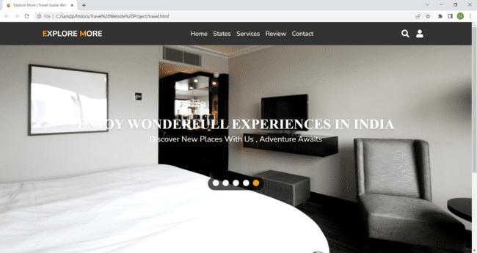
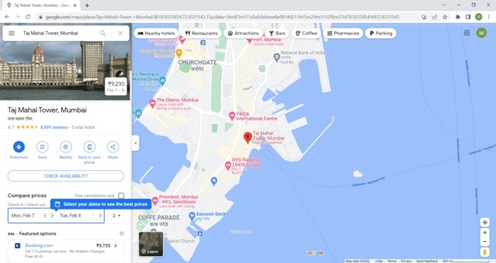
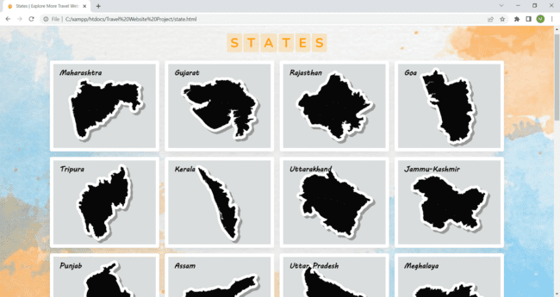
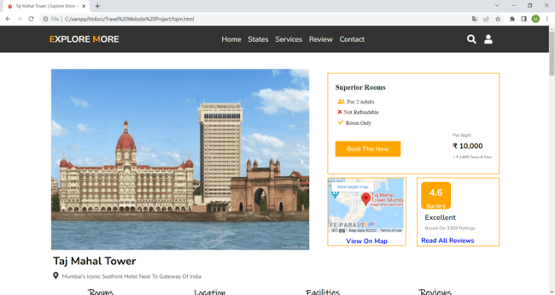
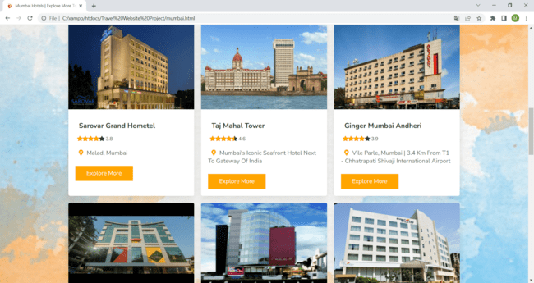
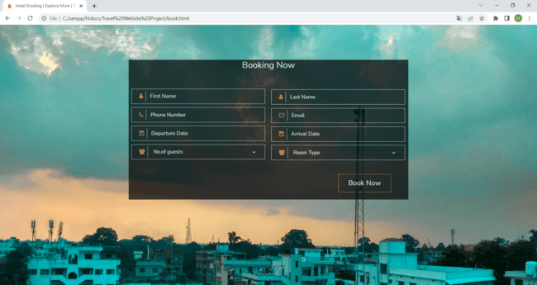
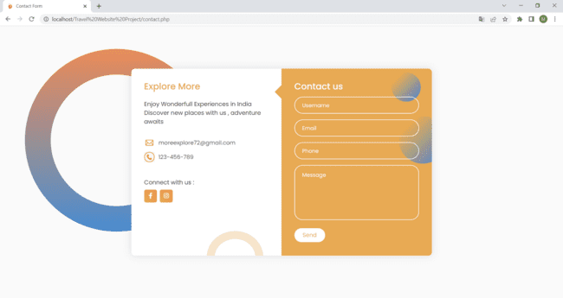
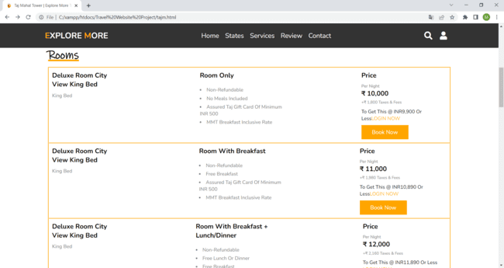
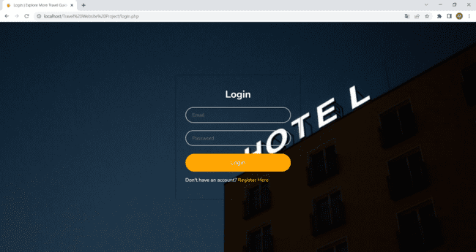
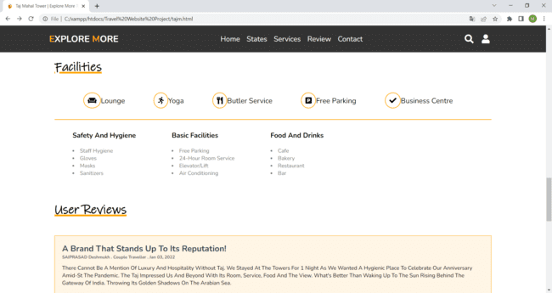
SNAPSHOTS

Slide 10
Future scope:
We can make the Web Design friendlier and more functional in the next development. The Online Hotel Booking System aims to provide a user-friendly interface and more functions for real world hotels. But there is still some room for improvements. For example, we can change. the settings and functions of some options in the Web pages to make them more professional and artistic. we can also use more pop-up windows so that users can choose the value from them directly. This applies to "arrival date" and "departure date" options. In this way the users can avoid many possible mistakes caused by inappropriate input.
In future improvements, the Online Hotel Booking System can offer more services such as car rental, flight ticket purchase, and the vacation package advising. These services have been offered already on some real world online booking systems. More hotels will add these , services on their online systems. In this way, people can make all their requests at once no matter they are business trip arrangement, shopping, travel, or vacation.

Slide 11

Conclusion:
The Online Hotel Booking System provides an environment for users to book hotel rooms, perform booking activities, and manage personal account with a Web browser. The system uses Apache Web Server running on Windows platform. The database server is MySQL. To implement the system, the developer has used JavaScript, HTML, and PHP. All dynamic contents are handled by PHP. Persistent data are saved in the database. Online Hotel Booking System is a user-friendly and easy-to-use system of a Web-based application. Everyone who knows how to use a Web browser can register and then login to book a room, change booking details, cancel booking, and view or modify personal profile online. It is easy and fast to make a reservation

Slide 12


